Slide 1



SpendWise
Expense Tracker
https://github.com/ksu-is/SpendWise
IS3020 APPLICATION DEVELOPMENT
Spring 2023
PRESENTED BY
Julianie “Jules” Ferguson
SpendWise Inc.

Slide 2

Keep track of your expenses and achieve your financial goals with our intuitive app.
From entering expenses to setting budgets and exporting data, SpendWise provides everything you need to manage your spending habits and save smarter.
Key Features
Enter expenses with amount, category, and message details
View expenses based on date and category filters
Compare expenses between two months
Check the balance of all expenses
Update the total budget balance
Calculate savings required to reach financial goals
Set a budget for different expense categories
View budgets for all categories
Import & Export expenses data
SpendWise Inc.

Slide 3

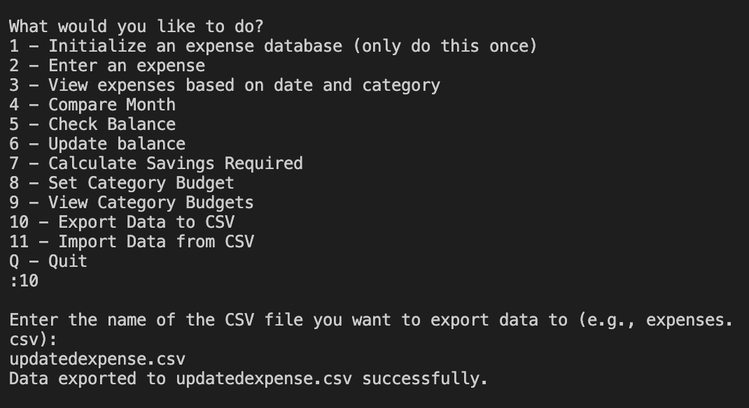
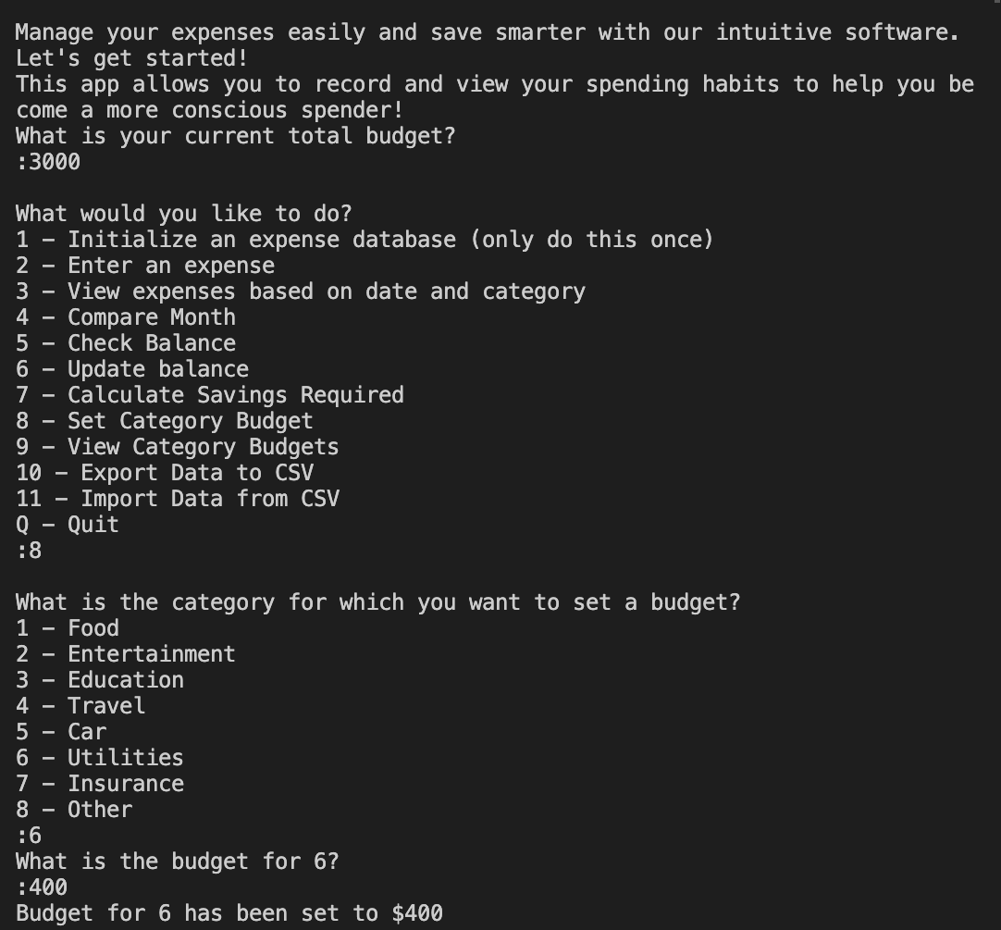
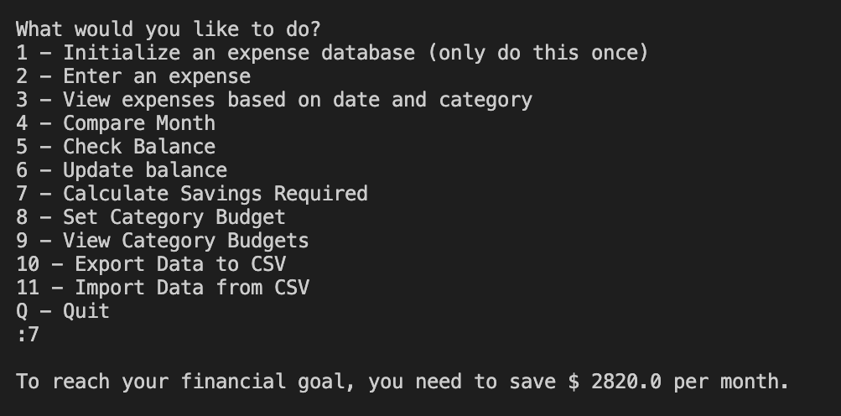
Import/Export Data
Categorize Expenses
Savings Calculator
SpendWise Inc.

